Slide 1
Idea 1: Fukushima’s Fallout
Creative Brief: Enemy Types

Slide 2
Enemy Types
There will be 4 kinds of enemies this game:
Mutated Humans (Lost their mind, but still resembles humans)
Wallers/Sleepers (Mutants that have went into a deep sleep due to inactivity, but can be awoken up if there is enough sound)
Wild dogs (Weak, but they come in packs, can be baited)
Bears (Strong animals, can be baited)

Slide 3
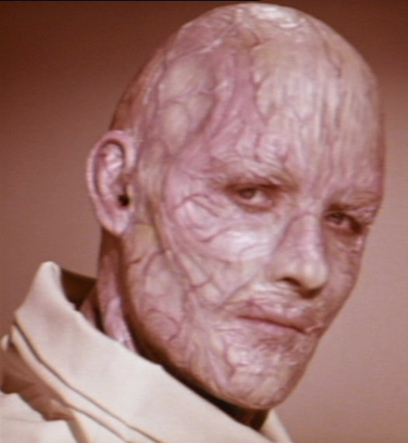
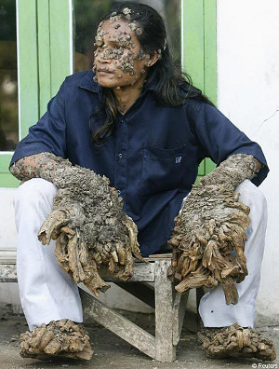
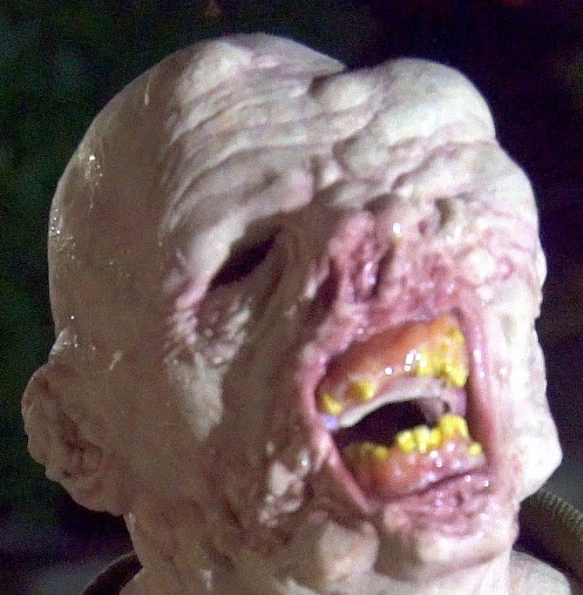
Mutated Humans
Mutated but still recognisable
Semi-afk, alerted via sound/sight
1 bullet to kill (headshot) 3 to body
Can be attacked by wild animals
Attracted to sound (Can be distracted)

Slide 4
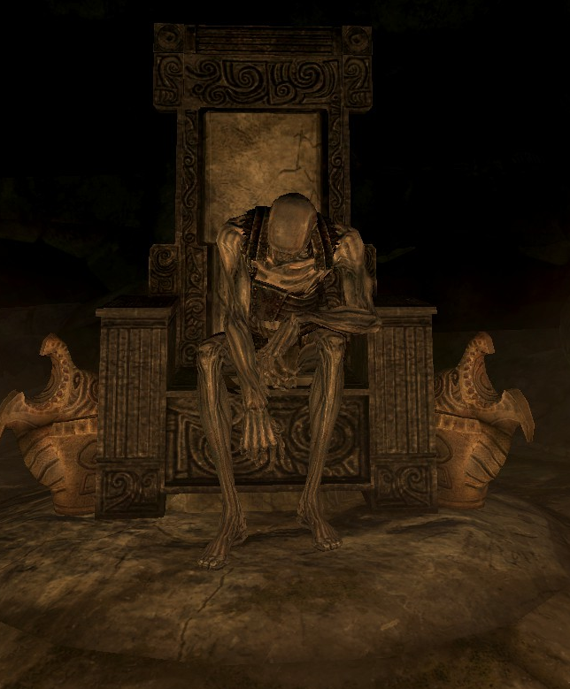
Wallers/Sleepers
Mutated, not recognisable
Awakened by sound (Player walking past, shooting bullets, etc)
2 bullets to kill (headshot) 5 to body
Can be attacked by wild animals
Once awoken, will keep chasing player
Proximity-awakening (See video)

Slide 5
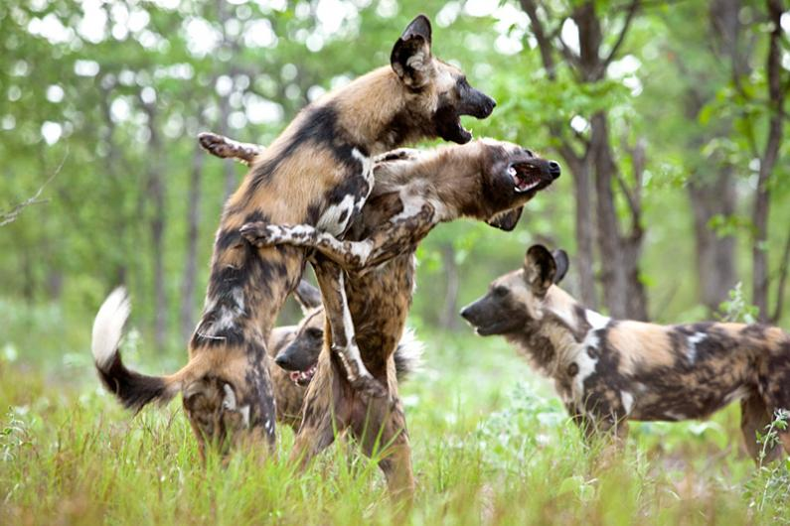
Wild Dogs
Regular wild dog
Attracted by sound (maybe smell?)
1 bullet to kill (headshot) 2 to body
Roams in packs, at least 2
Will keep chasing player
Can be baited

Slide 6
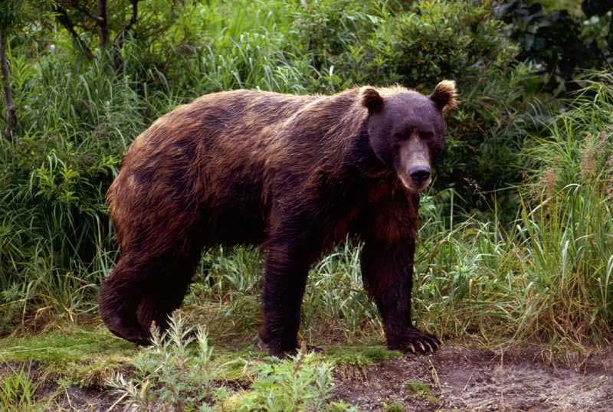
Bears
Regular bear
Attracted by sound (maybe smell?)
VERY TANK
Roams solo, one hits player
Can be baited to attack mutants
Will stop chasing once far enough

Slide 7
References (Videos / Images)
Live examples of how the mechanic roughly works

